Slide 1
Developer Training
Lab 5: Advanced Component Library

Slide 2
Agenda
Real world scenarios with Component Library:
Removing empty elements
Localizing text strings
Making an ASP.net master page
Making a custom navigation wrapper

Slide 3
Removing empty elements

Slide 4
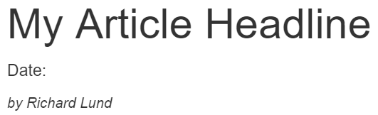
Removing empty elements
Add a date to your Article component, above the Byline
  <p>Date: {article_date}</p>
  I’ll use a text component for now, but we could also make a Date component
Save, then test it out on your page
That works nicely, until I leave the input field blank

Slide 5
Removing empty elements
In Visual Studio, navigate to the Components folder inside Component Project
Edit Components_YourNameArticle.cs
Replace line 34 with the following code:
var markup = OutputBase(asset, context, name, index, isDrag);
if (string.IsNullOrWhiteSpace(asset.Raw[name + "_article_date" + index]))
{
markup = new System.Text.RegularExpressions.Regex("<p>Date:.*?</p>").Replace(markup, "");
}
return markup;

Slide 6
Removing empty elements
Refresh the article preview
The empty field has now gone
It works, but we’ll have to write this code a lot
That may be acceptable, or we can refactor to make it easier
Make a new component: Your Name Article Date
  Use the same markup as before

Slide 7
Removing empty elements
In Visual Studio, edit Components_YourNameArticleDate.cs
Replace line 34 with:
if (string.IsNullOrWhiteSpace(asset.Raw[name + "_article_date" + index]))
return string.Empty;
return OutputBase(asset, context, name, index, isDrag);
Also undo your changes in Components_YourNameArticle.cs

Slide 8
Removing empty elements
Remove the Date line from your article and replace it with:
  {article_date : YourNameArticleDate}
Refresh your article preview
This is better, as the code only needs to be written once

Slide 9
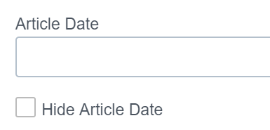
Removing empty elements
Another option would be to give the user an explicit choice
Edit the Your Article Date component and prepend:
  {hide_article_date : Checkbox}
Save and reload the component definition
Go to the Preview Content tab
A checkbox has the value “yes” if it’s checked
  Empty string (or not set at all) if unchecked

Slide 10
Removing empty elements
Edit Components_YourNameArticleDate.cs
Replace the code testing for an empty field with:
if (asset.Raw[name + "_hide_article_date" + index] == "yes")
return string.Empty;
Return to your article and refresh
This is probably better, but requires an extra action from the user
  Certainly a better option for complex components
  Regular expression can be fragile and broken by small markup changes

Slide 11
Localizing text strings

Slide 12
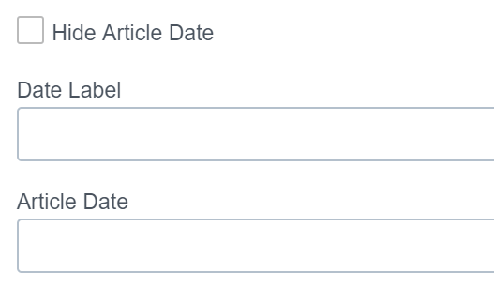
Localizing text strings
Modify your Article Date component to have the following markup:
  {hide_article_date : Checkbox}
  <p>{date_label : Text}: {article_date : Text}</p>
Save the component and refresh, then view the Preview Content tab
  (Note that I reordered the components using the Component Details panel)
This is the most basic way to enable localization
But the user will have to enter text on every use

Slide 13
Localizing text strings
A better option is to make a component to hold your translations
Create a new component: Your Name Translations
Add the following markup
  {date_label : Text}
Save your component to create it

Slide 14
Localizing text strings
Create a new template definition: Your Name Translations Template
Add your translations component
You don’t need to select a wrapper
But check the Create checkbox, and select your folder inside Templates
Save to create your new template

Slide 15
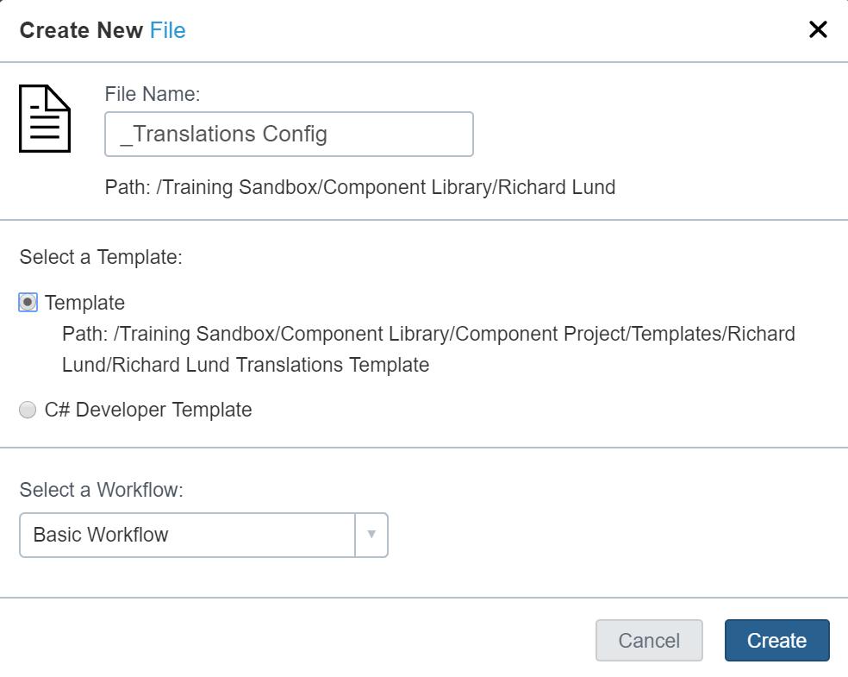
Localizing text strings
Create a new asset using your new Translations template
Name it _Translations Config
Go to Form View and enter a label
E.g. “Translated Date”
Save the asset
Stop it publishing a file
  Can you remember how?

Slide 16
Localizing text strings
Create a new component: Your Name Translated Text
Leave the markup empty, and click Save to create it
We don’t need an input experience
The component output code will find a translation and output the text
Edit Components_YourNameTranslatedText.cs

Slide 17
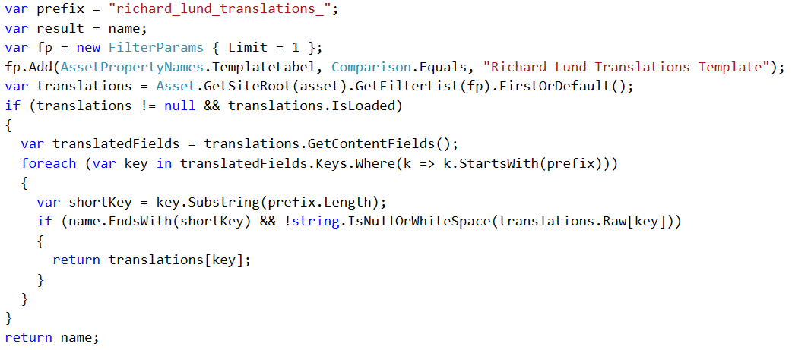
Localizing text strings
Replace line 34 with:

Slide 18
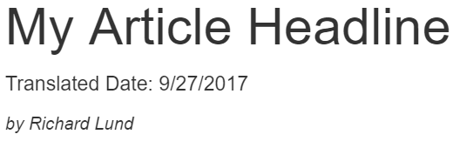
Localizing text strings
Update your Article Date component to use your new component
  {hide_article_date : Checkbox}
  <p>{date_label : RichardLundTranslatedText}: {article_date : Text}</p>
Update your article and fill in the date, and make sure the checkbox isn’t checked
Save and preview

Slide 19
Localizing text strings
In the real world, we would need to find a better way to locate the Config asset
Typically establish a pattern where locales live under the site root
Walk up the tree to find the nearest locale
Then use GetFilterList() to find the Translation Config under there
Don’t forget it needs publishing too, else it won’t get found at publish time
You could do this many other ways – e.g. a TranslationHelper class

Slide 20
Making an ASP.net master page

Slide 21
Making an ASP.net master page
The navigation wrapper is very quick and simple to create
Great for simple sites or landing pages
For larger site, having the navigation baked onto each page is expensive
Each change to the navigation means a republish of every page
Worth taking a small maintenance hit to save this effort for your users

Slide 22
Making an ASP.net master page
In Visual Studio, navigate to your folder under Templates
  Note, NOT Template Definitions!
Right-click and create a new Template C#
  Name it Your Name Master Page
Copy in the markup from the Navigation Wrapper output.aspx
Add/modify code to output relevant ASP.net markup with/instead of CP code

Slide 23
Making an ASP.net master page
At the top of the output:
if (context.IsPublishing)
{
%>
<$@ Master Language="C#" AutoEventWireup="true" $>
<%
}
%>

Slide 24
Making an ASP.net master page
At the end of the header:
<% if (context.IsPublishing) { %>
<asp:ContentPlaceHolder runat="server" ID="Header" />
<% } else { Out.Write(ComponentFramework.GenerateCssHeaderDeclarations(siteConfig));
Out.Write(metaData.ComponentOutput(asset, context, "meta"));
} %>

Slide 25
Making an ASP.net master page
Where the GetWrapContentPlaceholder() call is made:
<% if (context.IsPublishing) { %>
<asp:ContentPlaceHolder runat="server" ID="Body" />
<% } else {
Out.GetWrapContentPlaceholder();
} %>

Slide 26
Making an ASP.net master page
Just before the </body>:
<% if (context.IsPublishing) { %>
<asp:ContentPlaceHolder runat="server" ID="Footer" />
<% } %>
Create a new asset called site.master, using your Master Page template

Slide 27
Making a custom navigation wrapper

Slide 28
Making a custom navigation wrapper
Create another new Template C#
  Call it Your Name Custom Wrapper
Edit the output.aspx
If the current content is publishing
  Add code to output <asp:Content> items for your master page
Otherwise if it’s previewing
  Call out to your Navigation Wrapper

Slide 29
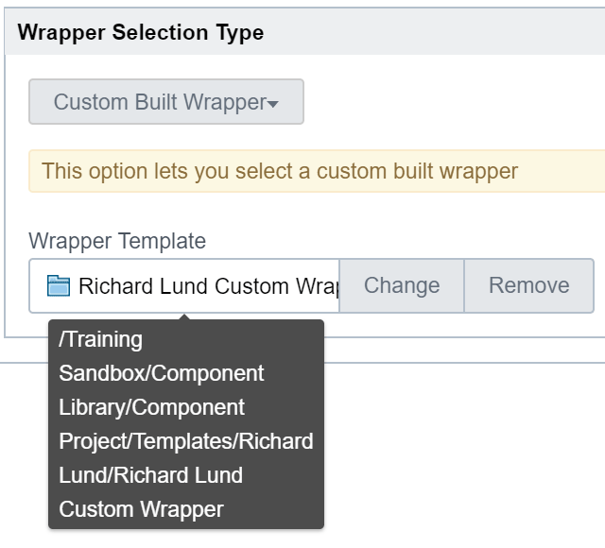
Making a custom navigation wrapper
Finally update the Article template to use your new Custom Wrapper
Edit Your Name Article Template
  Inside Template Definitions
  Go to the Wrapper tab
  Change to Custom Built Wrapper
  And select the template from Templates,
  not Template Definitions
Finally preview your Article again
Compare with View > Output from the menu

Slide 30
Making a custom navigation wrapper
Note that you might get timeouts viewing output for Draft assets
  Publish to stage or live and try it again
This makes publishing much less onerous for the user
Just need to remember to update the Master Page if the Wrapper is updated
Establish a process for this

Slide 31
Thank You!

